Slide 1
Maintaining kidney health in people with ileostomies
Ileostomy Association Information Day
25th April 2026
Shelagh Bickerton
Lead AKI Nurse Specialist, RWT
National Chair of ANN UK AKI COP
Shelagh.Bickerton@nhs.net

Slide 2
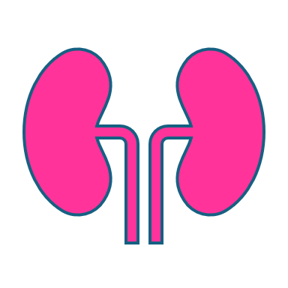
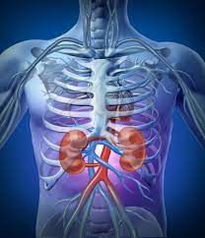
The Kidneys
Most people have two kidneys
Bean-shaped organs which sit in the middle of your back
They are the hardest working organs in your body
Make approximately 2 litres urine/day
They filter waste products from the body.
They control the amount of salt and water in your body
They help to regulate blood pressure
They help to keep the bones strong and healthy
They help to make red blood cells which carry oxygen around the body

Slide 3
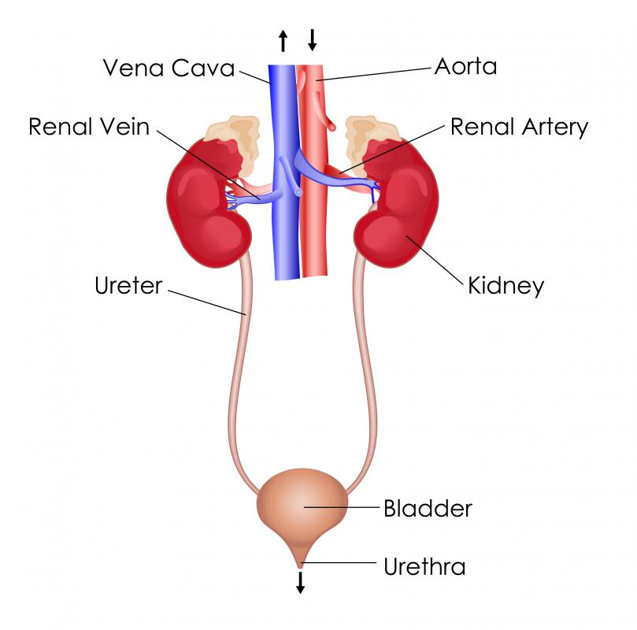
To function, kidneys need….
Adequate blood pressure/blood volume
(pre-renal)
To be healthy, rather than damaged or inflamed by disease process (intrinsic)
To drain urine freely through a functioning urinary tract (post-renal)
eg, dehydration, sepsis, acute heart/liver failure, bleeding, shock
eg, vasculitis, glomerular nephritis, ATN
eg, kidney stones, enlarged prostate, pelvic cancers, constipation

Slide 4
Acute Kidney Injury
Acute Kidney Injury (AKI) is the acute deterioration in kidney function that presents over a period of hours or days.
It is estimated that one in five people with admitted to hospital each year as an emergency has AKI. (NCEPOD Adding Insult to Injury 2009).
Up to 30% of AKI could be prevented with the right care and treatment.
Financial burden to the NHS estimated to cost £3.2 billion pa (1% of the NHS budget).

Slide 5
Chronic Kidney Disease (CKD)
CKD is a long-term condition characterised by a gradual deterioration in kidney function occurring over months or years.
Stages 1-5 (mild to end-stage)
Associated with an increased risk of cardiovascular complications such as a heart attack or stroke.
Main causes
Poorly controlled diabetes
High bloods pressure
Inflammation within the kidneys
Family history of kidney disease (inherited causes)
Blockages to flow of urine (eg enlarged prostates, kidney stones, pelvic masses)
Certain medications
Repeated AKIs

Slide 6
Risk of AKI in patients with ileostomies
1 in 340 people have a stoma in the UK (over 200,000 people).
Having an ileostomy is an independent risk factor for the development of AKI, due to the increased risk of dehydration.
  25-40% of patients will develop a high output ileostomy (HOI) ¹
  Up to 38% will require hospital admission due to HOI and AKI ²
  Readmission rates are > 10% within 60 days ³
  25% will develop chronic kidney disease (CKD) within two years of stoma formation ⁴
  66.6% - 75.3% of patients with CKD will develop cardiovascular disease (CVD), with mortality increasing with declining kidney function ⁵
  CVD is the leading cause of death in patients with CKD ⁶
  Ileostomy>>AKI>>CKD>>increased risk of morbidity and mortality
Notes:
Ileostomy is a small bowel stoma formed for a variety of reasons such as cancer or IBD.

Slide 7
Causes of high output stomas >1.2L/24hrs (watery consistency)
Newly formed stoma
Bowel affected by disease or treatment (eg, gastroenteritis, IBD, chemotherapy)
Short gut syndrome
Partial bowel obstruction
Non-adherence with diet/medications such as loperamide.

Slide 8
Dehydration – low BP/circulating volume – poor renal perfusion – AKI.
Medications may not be absorbed properly due to fast gut transit time.
Under nourishment – weight loss, muscle loss.
Electrolyte imbalance – heart arrythmias.
Leaking stoma bags – poor skin integrity.
Psychological consequences – loss of confidence, social isolation, depression & anxiety.
Consequences of high output stomas/fistulas

Slide 9
Addressing the issue….
Development of a patient information leaflet for people with ileostomies to improve knowledge and understanding and therefore foster independence and promote kidney health.
Development of an assessment tool for colorectal/stoma nurses to triage patients for early intervention, which will reduce the risk of short and long-term kidney damage.
Improving in-patient care for patients with HOI – extending current national guidelines to include renal-protective strategies, including post –discharge care.
Notes:
Raj to do

Slide 10
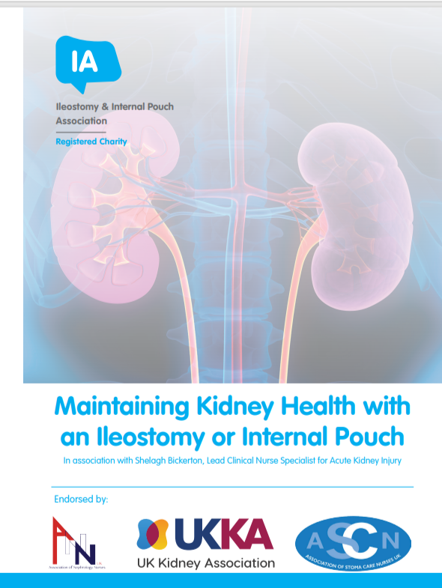
Patient information leaflet (V6)
Developed in collaboration with patient representatives from the Ileostomy Association
Aims to improve understanding and foster independence and confidence.
Uses a traffic light system for patients to self-assess and understand when and where to refer to if clinically unwell
Nationally endorsed by UK Kidney Association, Association of Nephrology Nurses UK, Association of Stoma Care Nurses UK.
Incorporated into post stoma surgery d/c information, 6-week review and also any episodes of AKI/post discharge AKI follow-up.
Free to order from the Ileostomy Association: iasupport.org

Slide 11
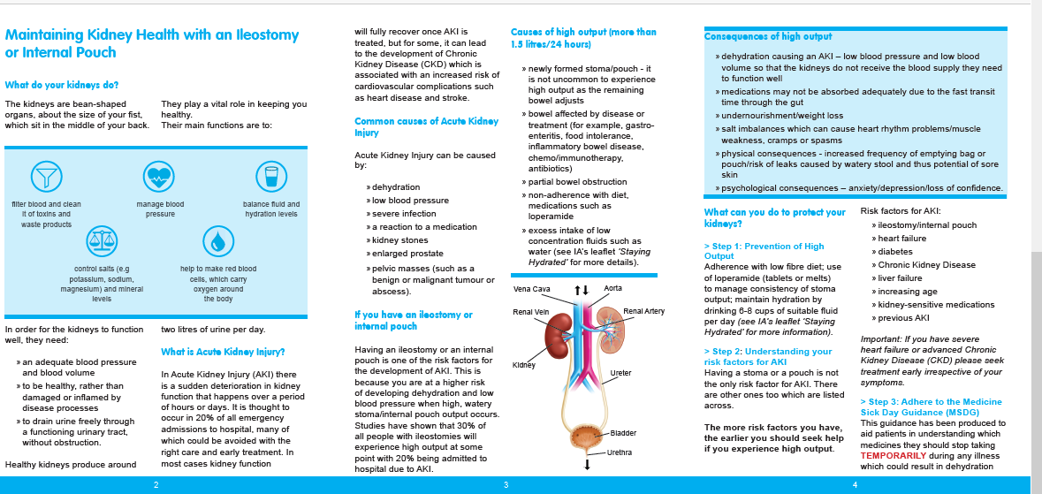

Slide 12
What can be done to protect the kidneys?
Prevention of high output
Understand individual’s risk of developing AKI
Adhere to the Medicine Sick Day Rules
Assess their symptoms according to RAG chart and take appropriate actions

Slide 13

Prevention of high output
Comply with low-fibre diet
Stagger eating and drinking
Take loperamide if needed to maintain output which is of porridge consistency
Drink 6-8 cups of suitable fluid per day to maintain hydration
Education about prevention and self-management of high output

Slide 14
Hydration
Water is vital as it helps with digestion and to flush waste products from your body.
On average, around two thirds of your body is water.
If the water content of your body is reduced, it can upset the balance of minerals (sugar, salts) and can lead to dehydration.
If your stoma/pouch output is ‘normal’ (porridge-like) then you are probably drinking adequately.
However, drinking lots of water alone, may on occasion, affect the balance of minerals and increase the risk of dehydration.

Slide 15
How can water increase dehydration?
When we drink water excessively, salt (sodium) moves through the wall of the intestine by processes known as ‘osmosis and diffusion’ – moving from high to low concentration…..from the body’s cells into the bowel. This ‘pulls’ the water from the cells into the bowel and therefore increases stoma/pouch output.
Sugar (glucose) is also needed for the absorption of salt from our food & drink in order to move salt (and therefore water) from our bowel to our cells.
Rehydration drinks are often referred to as ‘sugar-salt’ or ‘carbohydrate-electrolyte solutions’ eg St Mark’s or Dioralyte.
Dioralyte – contains little sodium and some potassium – useful if there is mild dehydration
St Mark’s Solution – contains some sodium but no potassium – useful in moderate to severe dehydration

Slide 16
Understand the risk factors for AKI
Ileostomy/
Pouch
Chronic Kidney Disease
Diabetes
Heart failure
Cognitive/
physical restriction
Liver failure
Age
Kidney-sensitive medications
Enlarged prostate/pelvic masses/stones
History of AKI
If they have severe heart failure, or severe CKD, seek help early, regardless of symptoms

Slide 17
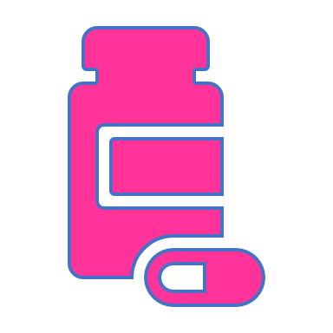
Medicine Sick Day Rules (MSDR)
Dehydration can be a significant risk to the development of AKI in people taking certain medicines.
MSDR aid people in understanding which medicines they should temporarily stop during any illness which can result in dehydration.
It is vital that these medicines are restarted when they are well (normally 24-48 hrs) oce the illness settles and they are eating and drinking normally again.

Slide 18
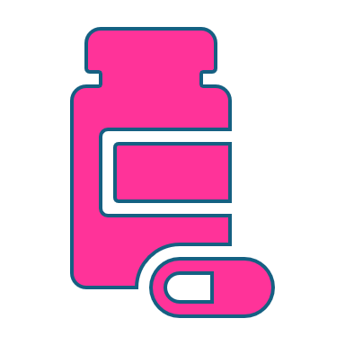
Medicine Sick Day Rules
Angiotensin Converting Enzymes Inhibitors (ending in ‘pril’) – antihypertensive
Angiotensin Receptor Blockers (ending in ‘sartan’) – antihypertensive
NSAIDS – analgesic, eg ibuprofen, diclofenac, naproxen
Metformin – diabetic drug
SGL2T Inhibitors (ending in ‘flozin’) used in diabetes, heart failure and CKD
Diuretics (‘water tablets’) eg furosemide, Bendroflumethiazide, spironolactone
If blood pressure is low, please also suspend any other antihypertensives

Slide 19
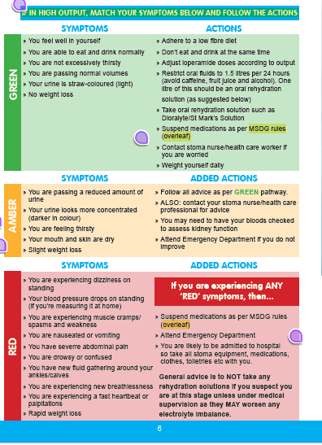
Self assessment as per RAG chart
For people to determine if they are safe to self-manage at home, or they need to seek advice from colorectal nurse specialists, or present at one of the emergency portals.

Slide 20
GREEN (mild)
Symptoms
Patient feels well & not thirsty
Able to eat and drink normally
Passing normal volumes of urine
No weight loss
Review
Follow-up call and reassessment in 48 hours
Advice if deteriorates
Actions
Diet – low fibre
Stagger eating & drinking
Titrate loperamide –aim for porridge consistency
Restrict oral fluid intake to 1.5Lin 24hrs
Oral rehydration such as Dioralyte/St Mark’s solution
Suspend drugs as per MSDR
Stool sample if cause unclear

Slide 21
Amber (moderate)
Symptoms:
Passing reduced amounts of concentrated urine
Feeling very thirsty – dry mouth, skin, sunken eyes
Slight weight loss
Review:
Bloods review <24 hours. Discuss with surgical reg/renal team if AKI 1-3. Arrange admission if necessary.
Advise to attend emergency portal if patient deteriorates.
Added actions:
Bloods (U&Es, Mg, Po4, Ca, Bicarb, FBC) within 24 hours.

Slide 22
RED (severe)
Symptoms:
Severe abdominal pain
Dizziness on standing – BP drop on standing (>10%)
Rapid weight loss
Muscle cramps/spasms/weakness
Vomiting/nausea
Drowsiness or confusion
New fluids around ankles/calves
New breathlessness
Fast heartbeat or palpitations
Added actions:
Attend emergency unit (A&E, Surgical/medical emergency unit
Suspend medicines as per MSDR
Likely to be admitted so advise to bring all stoma equipment, medications, clothes, toiletries etc.

Slide 23
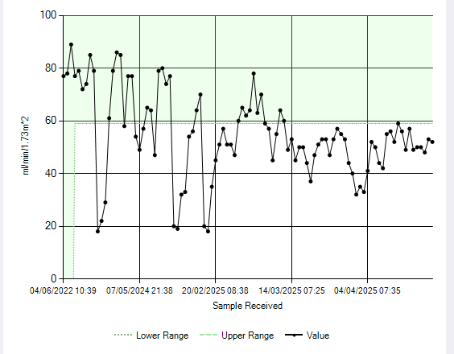
Effect of multiple AKIs on kidney function over time

Slide 24
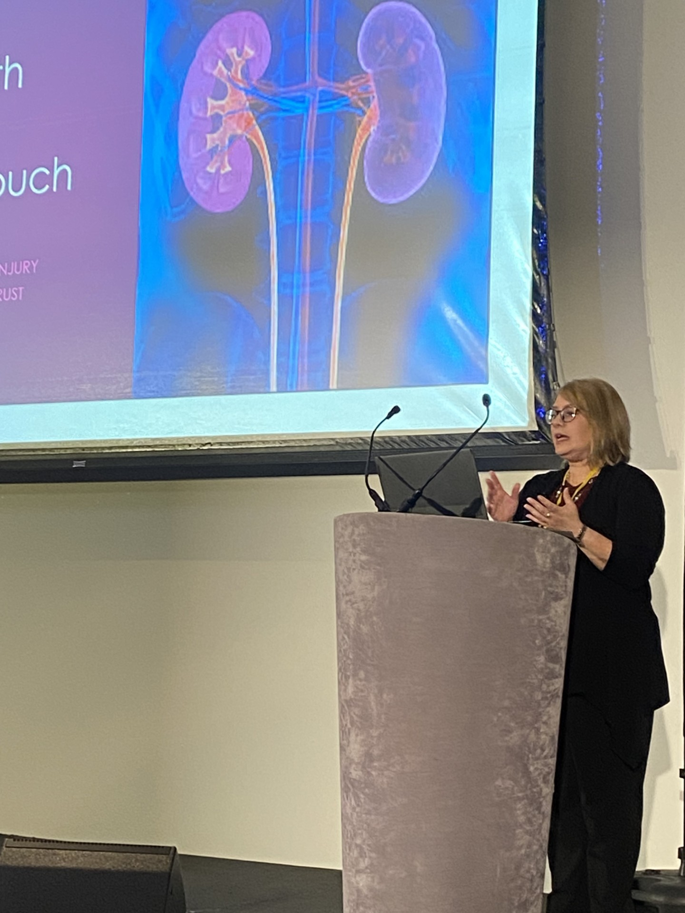
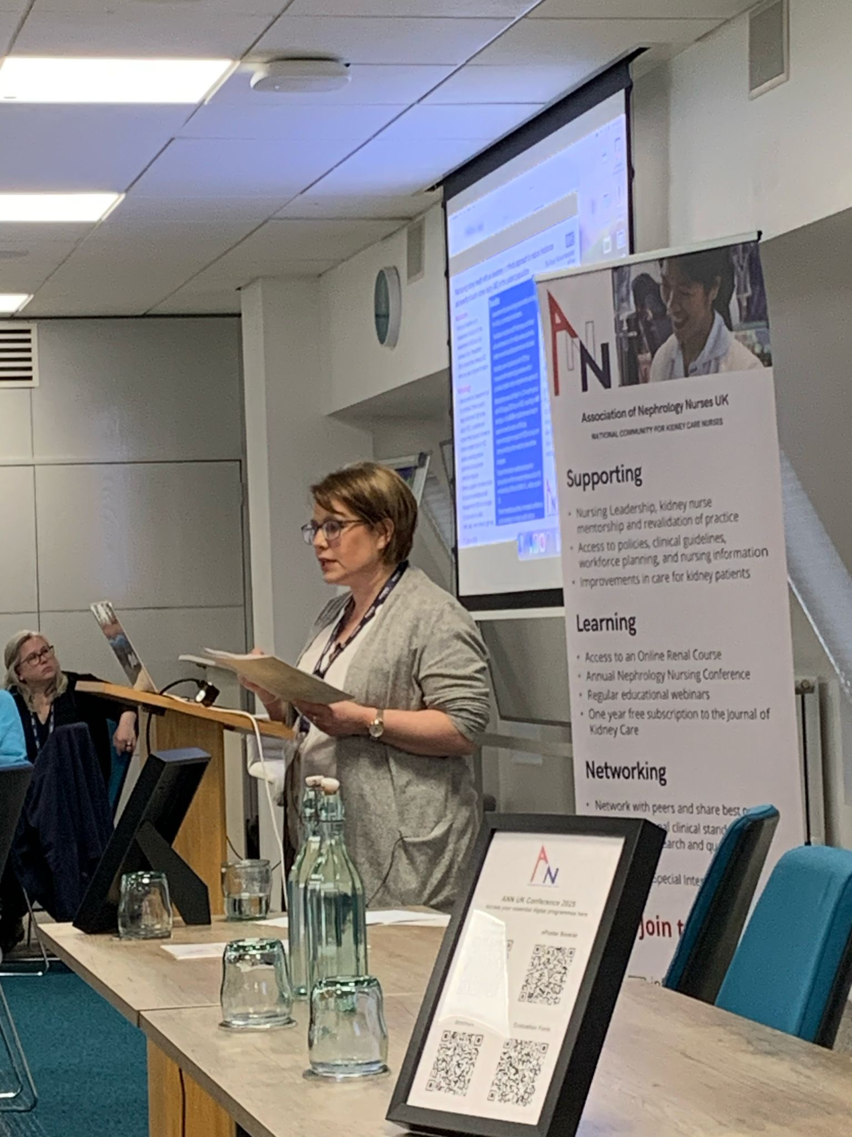
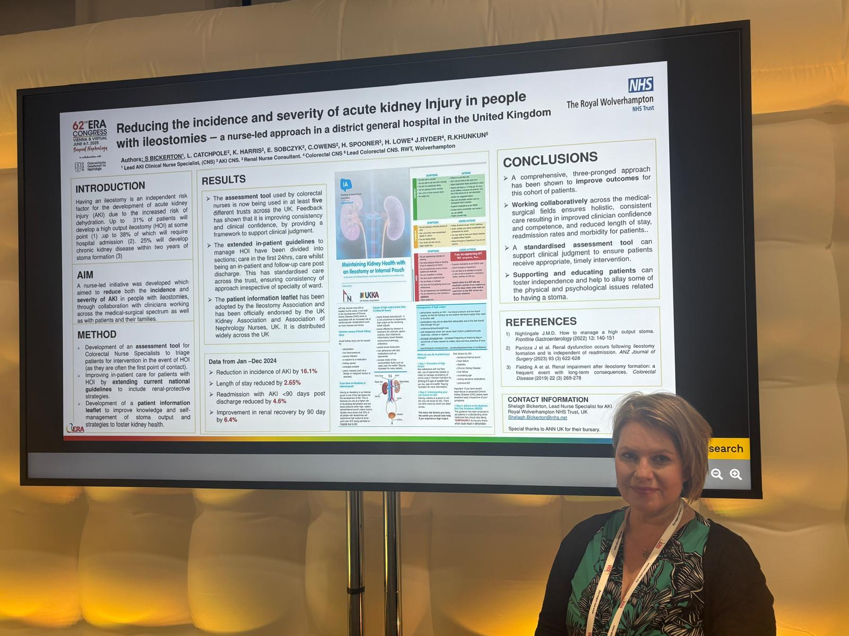

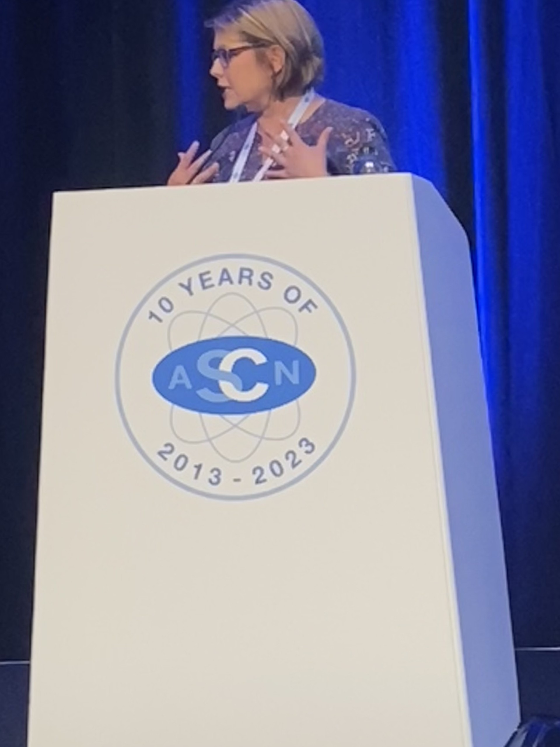
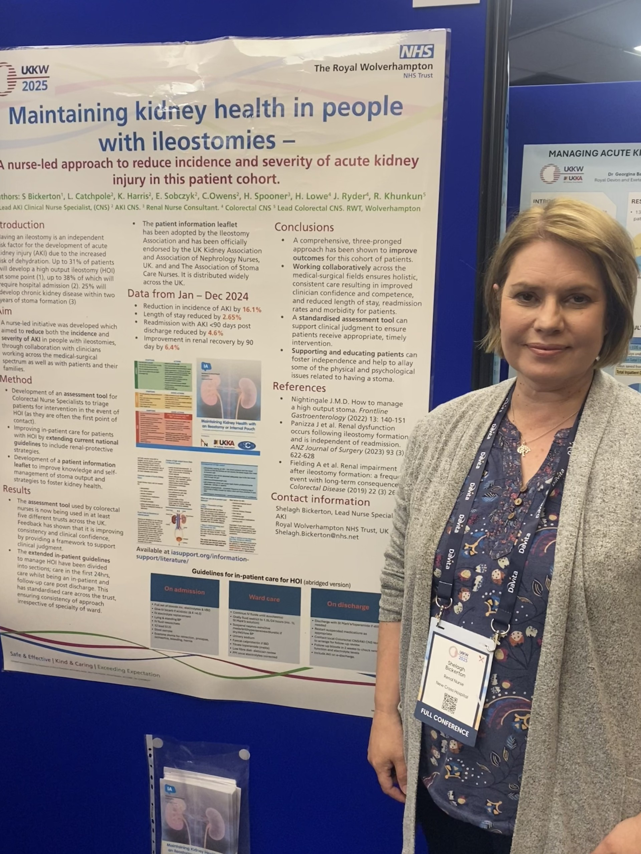
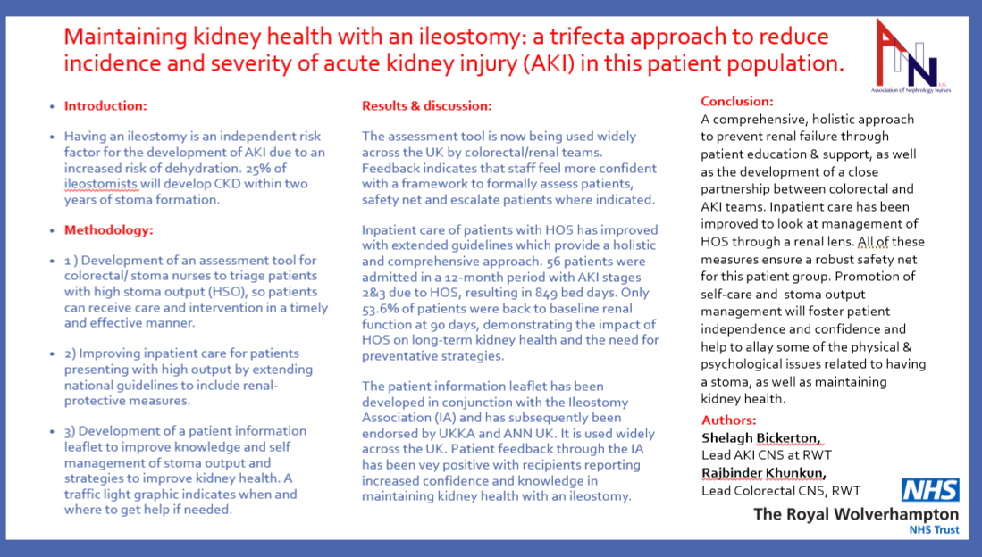
Dissemination of work,
regionally, nationally and
internationally.
Targeting renal, colorectal
and patient groups.
Notes:
Quickly attracted regional, national and international attention.

Slide 25
Should you be having your kidney function checked regularly?
Currently no national guidelines which support regular checking of bloods to monitor kidney function.
Pilot Project 2026 (Wolverhampton) – monitoring of renal function and other vitamins and minerals for a 2-year period following ileostomy formation. Aim: to include kidney health monitoring in ERAS programme.
For now, the advice is: follow traffic light system on IA leaflet and get help early if needed.

Slide 26
To conclude
Having an ileostomy or internal pouch is a risk factor for the development of acute kidney injury (due to the increased risk of dehydration).
Prevention of high output/dehydration is key to maintaining kidney health.
Early recognition of the signs of dehydration, and early intervention may prevent any acute kidney damage and reduce the risk of developing any long-term consequences.
The Ileostomy Association is always there to support and educate.

Slide 27
“I have had an ileostomy for a few years and have had repeated admissions to hospital with high output and kidney problems. It made me lose my confidence and also made me feel very unwell. I hated having a stoma. Now, with all the support received through this project I feel much more able to look after myself and manage my symptoms better. I know exactly what I need to do to get help if I need it and keep my kidneys safe. I feel like I have got my life back at last.”
Margaret, age 64, Wolverhampton

