Slide 1
IA's new counselling service
Carrie Helman / Aileen Macarthur
Ostomy Psychotherapists

Slide 2
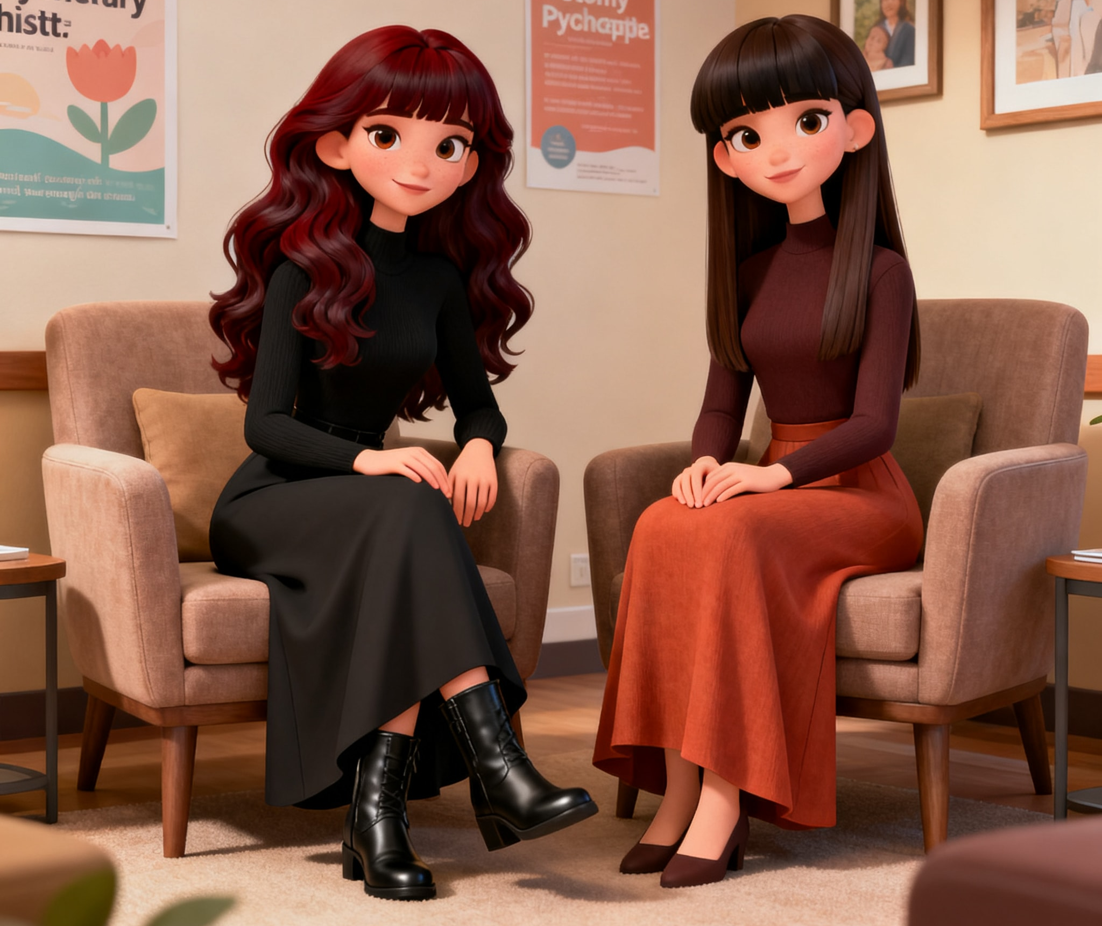
WHO ARE WE?
• Carrie: Psychotherapist & Ostomate
(25+ years)
• Aileen: Psychotherapist & Lived
Experience (caring for her late Mum
– an ostomate).
• Qualified & Lived Experience
• We Speak Your Language:
Professional support without the
need for medical explanations.

Slide 3
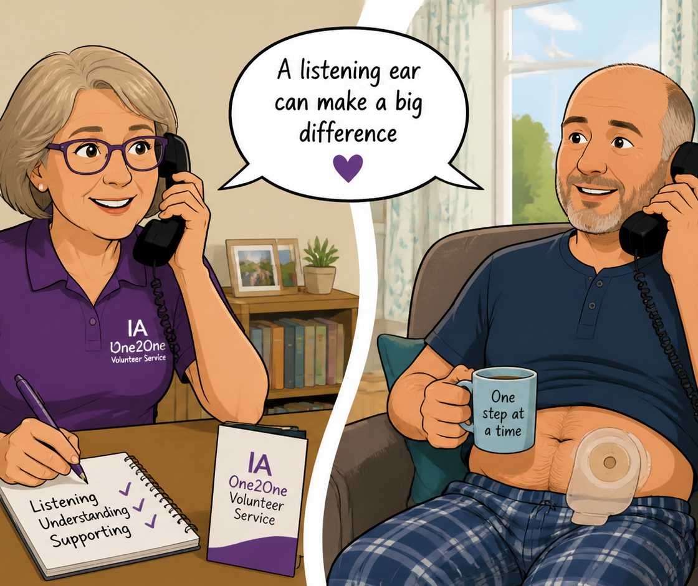
PEER SUPPORT: IA ONE2ONE
• Support from people like you
• Volunteers Experience: 18+ months with an ileostomy or internal pouch.
• Trained Listeners: Not clinical, but highly trained in communication.
• The Goal: Helping you make sense of your own journey.

Slide 4

IA’s NEW COUNSELLING SERVICE
• Free-of-Charge
• Pre-op Support: 3 Sessions.
• Post-op Support: 6 Sessions.
• Direct Contact: We reach out to you personally following a referral from Carol Katte (Stoma Nurse Liaison).

Slide 5
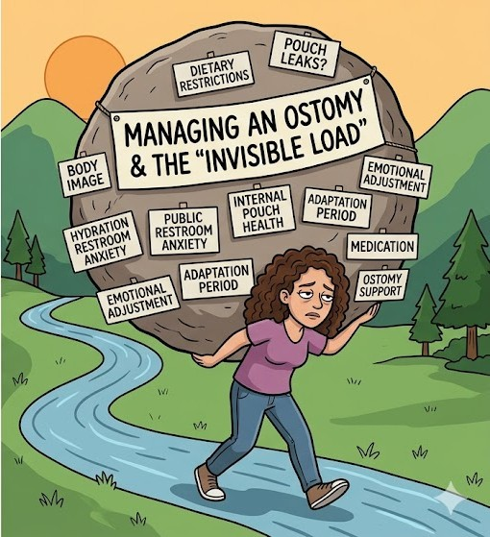
THE ‘MESSY MIDDLE’
• A Safe Space for the “Real” Stuff
• No “Filter” Required.
• Practical Empathy for “Bag-Brain.”
• Managing the invisible mental load.
Notes:
1

Slide 6
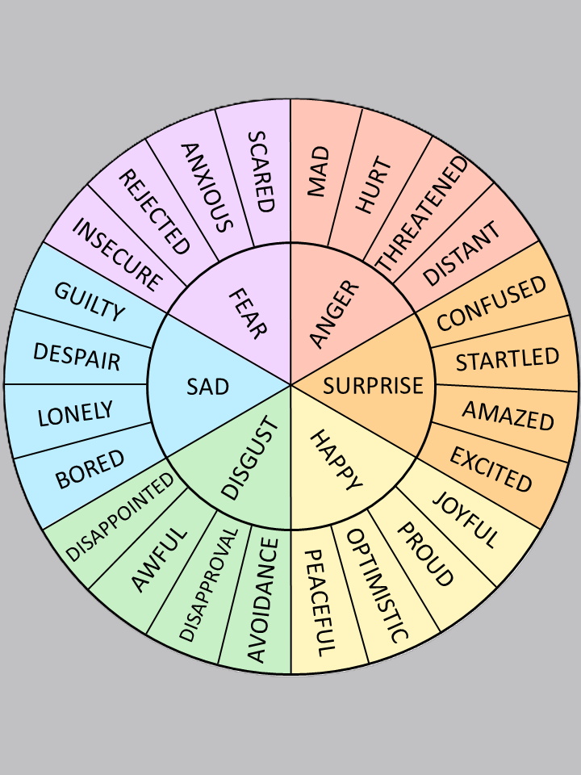
COMMON THEMES
• Body Image & Identity: Who am I now?
• Medical Trauma: Processing the 'How’ and 'Why.’
• Relationships & Intimacy: Navigating the "New Normal.“
• Hyper-vigilance: Managing the constant mental checks.

Slide 7
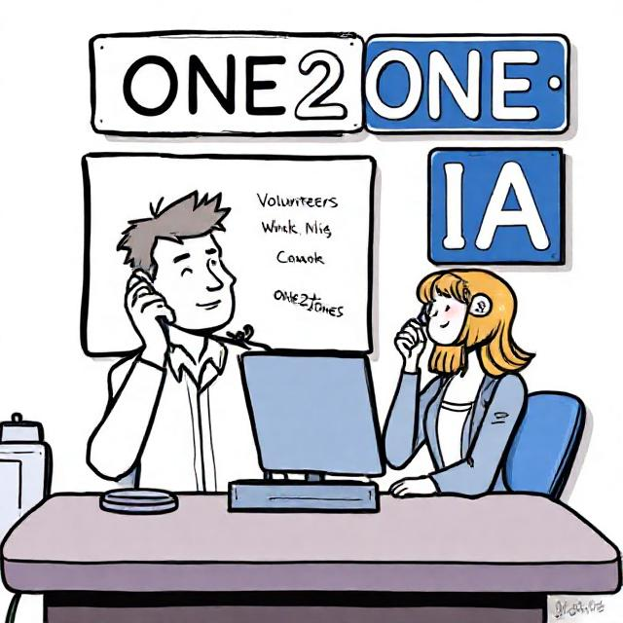
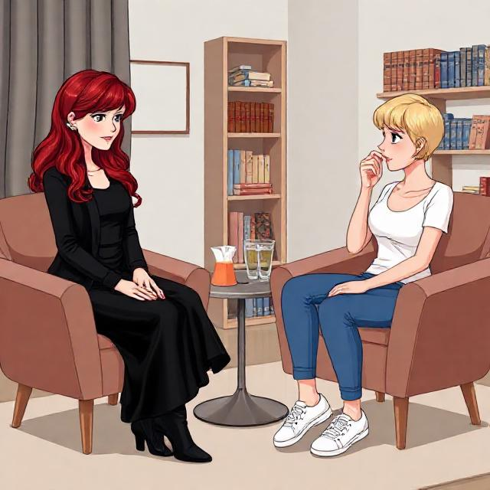
ONE2ONE -v- PSYCHOTHERAPY
• One2One Volunteers:
Practical tips, peer reassurance and
“The Path.”
• Psychotherapy:
Processing trauma, deep anxiety, and emotional "stuckness.
• The Partnership: You can use both!

Slide 8
YOUR JOURNEY, YOUR PACE
• Private & Confidential
• Accessible: Zoom or in Person.
• No pressure to be “positive”

Slide 9
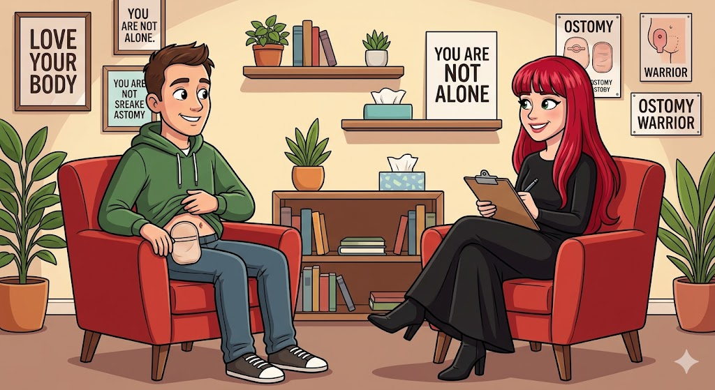
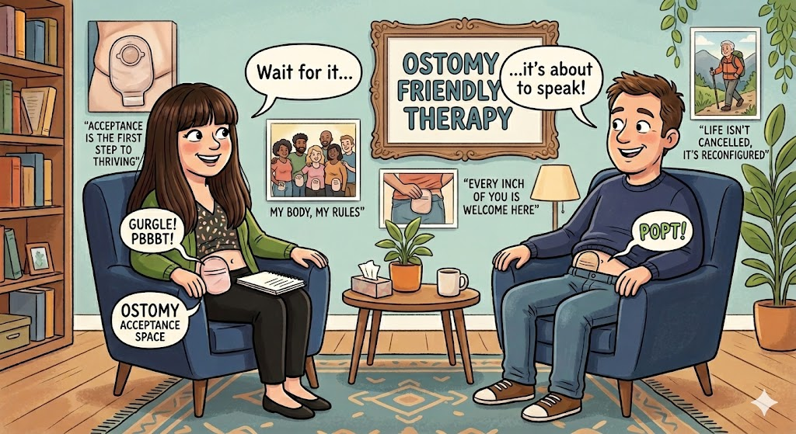
• Stoma Soundtrack
• Pouch Farts
• Scary Stirrings
….AND FINALLY!

Slide 10


