Slide 1

The use of Biological Therapy for Ostomy Patients
Dr Ayman Bannaga
PhD, FRCP
Consultant and Clinical Lead - Gastroenterology
Queen Elizabeth Hospital, Birmingham
Birmingham IA’s Information Day
Saturday 9th May 2026, Voco St John’s Hotel, Solihull

Slide 2
IBD
Definition
Pathophysiology/causes
Types

Slide 3
The UK burden of IBD
~500,000–540,000 people living with IBD in the UK
Around 1 in 123 people affected
~25,000 new diagnoses per year – increasing trend
UK has one of the highest prevalence rates in Europe
IBD is a disease of morbidity, not mortality. With modern treatments, patients are living longer — but the day-to-day burden of disease remains significant and is why we take medical treatment so seriously.
Notes:
Mortality is closer to general population with improved treatment

Slide 4
When does IBD lead to surgery
UC
Surgery may be needed when medication no longer controls disease
Colectomy (removal of colon) can be curative for UC
Often results in an ileostomy, permanent or temporary
Pouch surgery (ileo-anal) is an alternative for some patients
Crohn’s:
21% require surgery within 5 years of diagnosis
26% within 10 years — and many more over a lifetime
Surgery addresses strictures, fistulas, or uncontrolled segments
Biologics have reduced need for surgery — but cannot always prevent it
When I was a medical students >20 years ago the textbooks quote 85% of CD patients require surgery, in a lifetime. Nowadays this has reduced to 60%. Advanced/biological therapies reduce need for surgery in Crohns disease

Slide 5
Why Do Ostomy Patients Need Biologics?
Control inflammation and prevent flare ups
Target the immune pathways driving ongoing gut inflammation, even after surgery.
Protect remaining bowel
Improve quality of life
Less pain, less fatigue, better energy — so you can focus on living your life.

Slide 6
Types of Biological therapies in IBD ostomy patients
Anti-TNF drugs
Infliximab · Adalimumab · Golimumab
Block TNF-alpha, a key inflammatory messenger. Given by infusion or self-injection. The longest-established biologics in IBD. IV & S/C
Anti-integrins
Vedolizumab
Prevent immune cells entering the gut (gut-selective). It acts locally in the bowel rather than throughout the body. Lower systemic infection risk. IV and S/C
Anti-interleukins
Ustekinumab · Risankizumab · Mirikizumab · Guselkumab
Target IL-12, IL-23 or IL-23 alone. Newer generation — good safety profile and effective for moderate–severe disease. IV and S/C
Other advanced therapies – oral route
JAK inhibitors (Tofacitinib, Upadacitinib, Filgotinib)
S1P modulators (Ozanimod, Etrasimod)

Slide 7
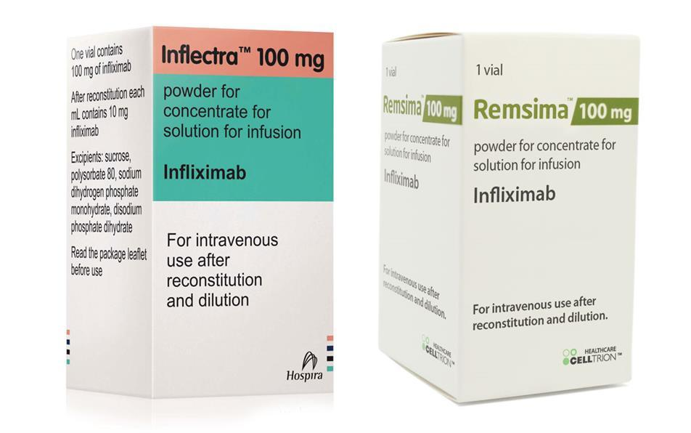
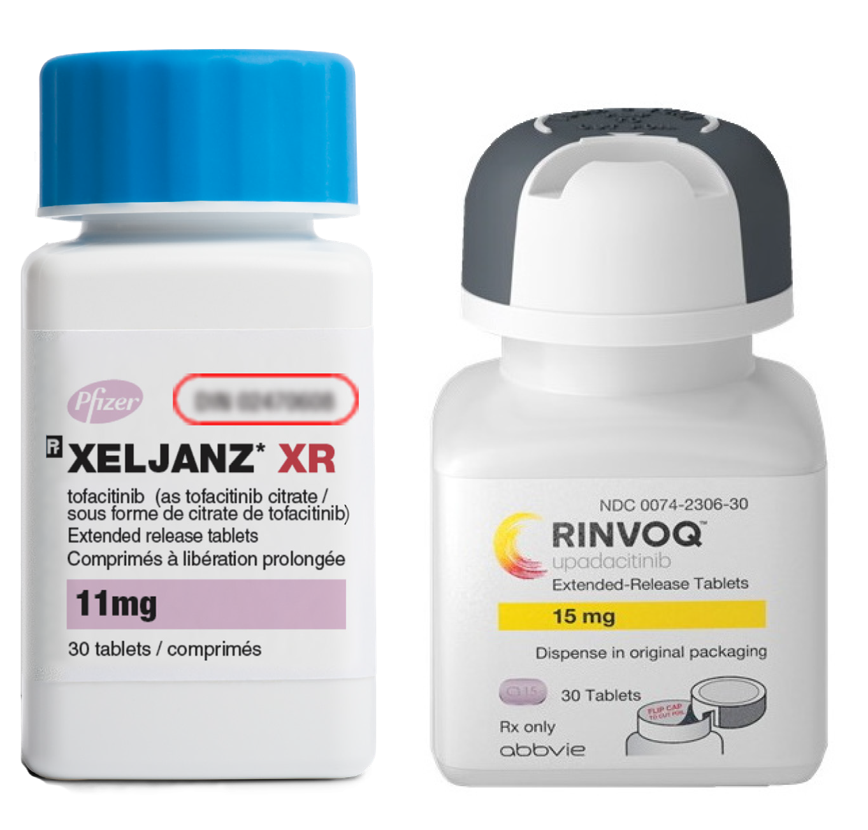
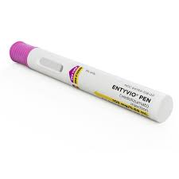
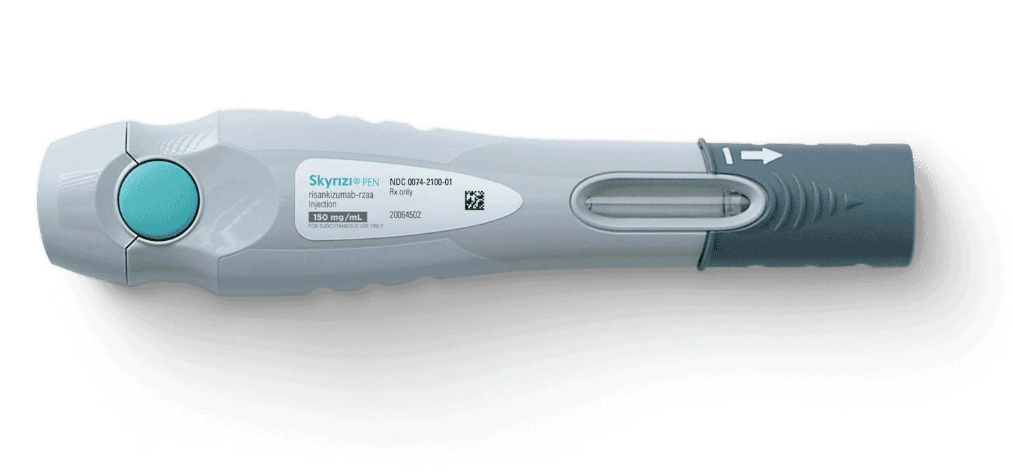

Slide 8
Biological therapy is safe — with the right safeguards in place
Risks to Know About
Increased susceptibility to infections, reactivation of TB, dormant viral infections, etc.
Fatigue or headaches, especially initially
Skin changes, paradoxical reaction (psoriasis, alopecia, Acne, dermatitis)
Rare: Lymphoma risk (particularly hepatosplenic T-cell lymphoma, mainly with anti-TNF + thiopurine combination in young males)
Rare: Non-melanoma skin cancer (NMSC) anti-TNFs and JAKis
Rare: Melanoma, possible signal with anti-TNFs
JAKi: ↑VTE risk, ↑MACE (tofacitinib >50yrs/CVD risk), herpes zoster reactivation, lipid changes, anaemia
Drug/pregnancy counselling

Slide 9
How we keep you safe?
Screening before starting:
TB screening (IGRA + CXR)
EBV, CMV, Hepatitis B & C serology
HIV testing
Varicella immunity/VZV vaccination if non-immune
Pneumococcal, influenza, COVID vaccines
Exclude active infection or septic focus
Malignancy history review
Cardiac function assessment if anti-TNF (CHF contraindication ≥NYHA III)
Regular blood test monitoring throughout treatment
Immunogenicity Anti-drug antibody (ADA) formation → loss of response (particularly infliximab and adalimumab) Combination with immunomodulator (azathioprine/MTX) reduces ADA formation
Therapeutic drug monitoring (TDM) guides optimization
MHRA regulates all biologics rigorously in the UK — drug safety is taken very seriously

Slide 10
What we check in the GI clinic - How we keep you safe on biological therapy
Nutritional status (weight, BMI, anaemia, etc)
Hydration status, stoma output volume & consistency (important in ileostomy patients, dehydration may point to other causes)
Infection signs (fever, systemic illness, injection site reactions)
Routine blood tests to catch side effects early (liver, kidney, blood counts, etc.)
Clinical stoma assessment (colour, size, peristomal skin/swelling, etc.)
How you feel (pain, fatigue, quality of life, your experience matters most)
Arranging relevant investigations (endoscopy, MRI, US, etc.)

Slide 11
Diversion Colitis
An often overlooked complication
What is it?
Inflammation that develops in the segment of bowel that has been diverted, has no longer faecal stream. It can occur in both Crohn's and UC ostomy patients.
Why it matters
It can cause bleeding, discharge, and discomfort from the defunctioned bowel, even when the main IBD is well controlled.
Treatment approach
Biologics that control IBD systemically can also help. Topical treatments (enemas, suppositories) to the diverted segment may be needed. Reconnecting the bowel (stoma reversal) resolves diversion colitis, but is only appropriate when the underlying IBD is in good remission.

Slide 12
What ostomy patients most commonly ask us about biological therapy?
"Will it affect my stoma?"
Usually, no direct effect on the stoma itself. Biologics work systemically to reduce inflammation in the bowel, not the stoma site.
"Is it lifelong?"
Not necessarily. It depends on your disease control and response. Some patients achieve sustained remission and treatment is stepped down.
"Will I feel better?"
Patients do see improvement. Less pain, more energy, fewer flare-ups. Response varies on the disease stage, and we monitor this closely.
"Is it safe?"
Yes, with the appropriate monitoring. The long-term safety data on these drugs is now extensive and reassuring.

Slide 13
Take home message
Biologics in ostomy patients help control IBD, and improve quality of life

