Slide 1
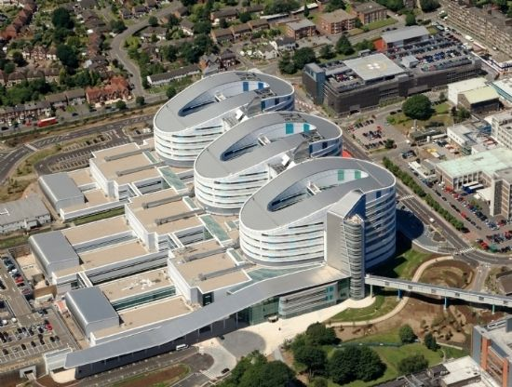
Treating cancer patients: resections, complications, challenges and successes
Melissa Oliveira Cunha PhD FRCS
Consultant Colorectal Surgeon

Slide 2
Colorectal cancer
The Big Picture

Slide 3
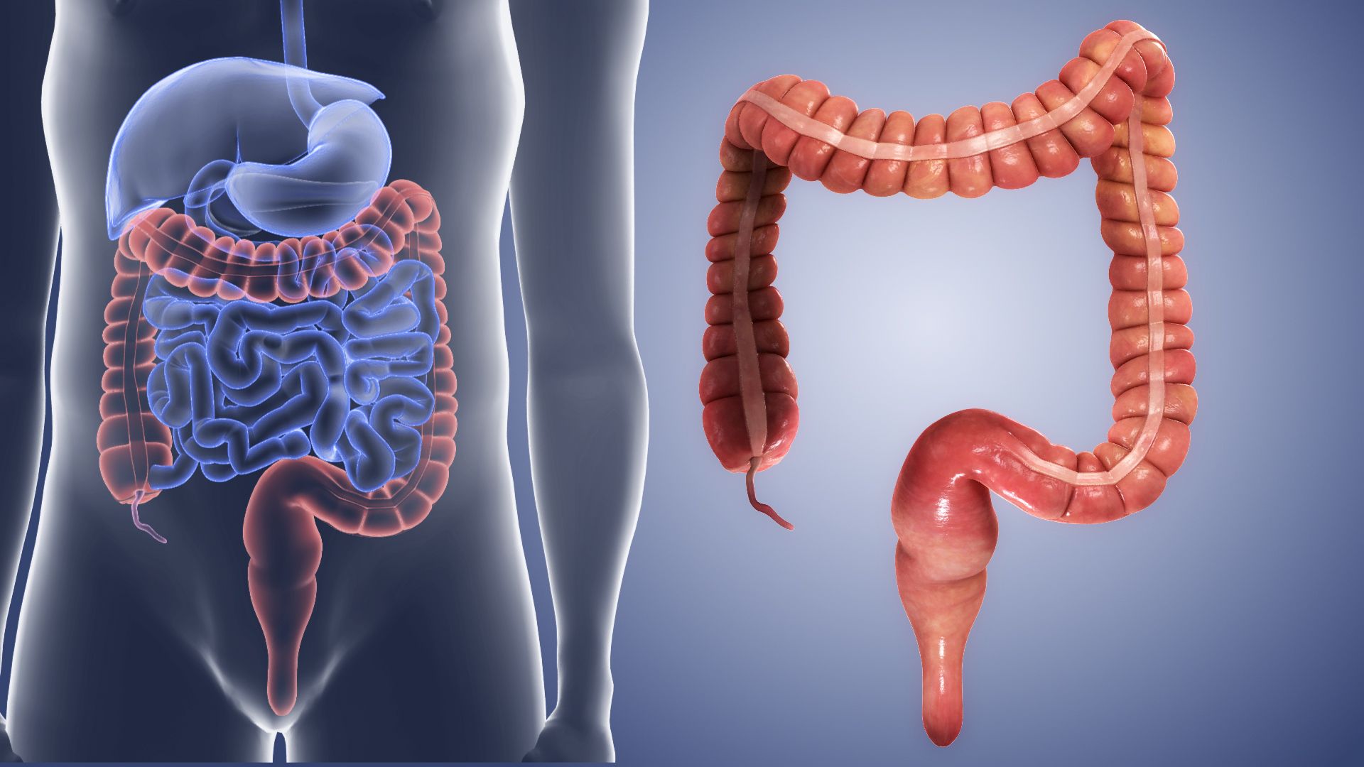
What is colorectal cancer?
Cancer of the large bowel (colon and rectum)
Almost 44k people are diagnosed every year in the UK.
More than 9 out of 10 cases are diagnosed in people over the age of 50.
12% of all cancers
Second most common cancer in UK when considering both sexes

Slide 4
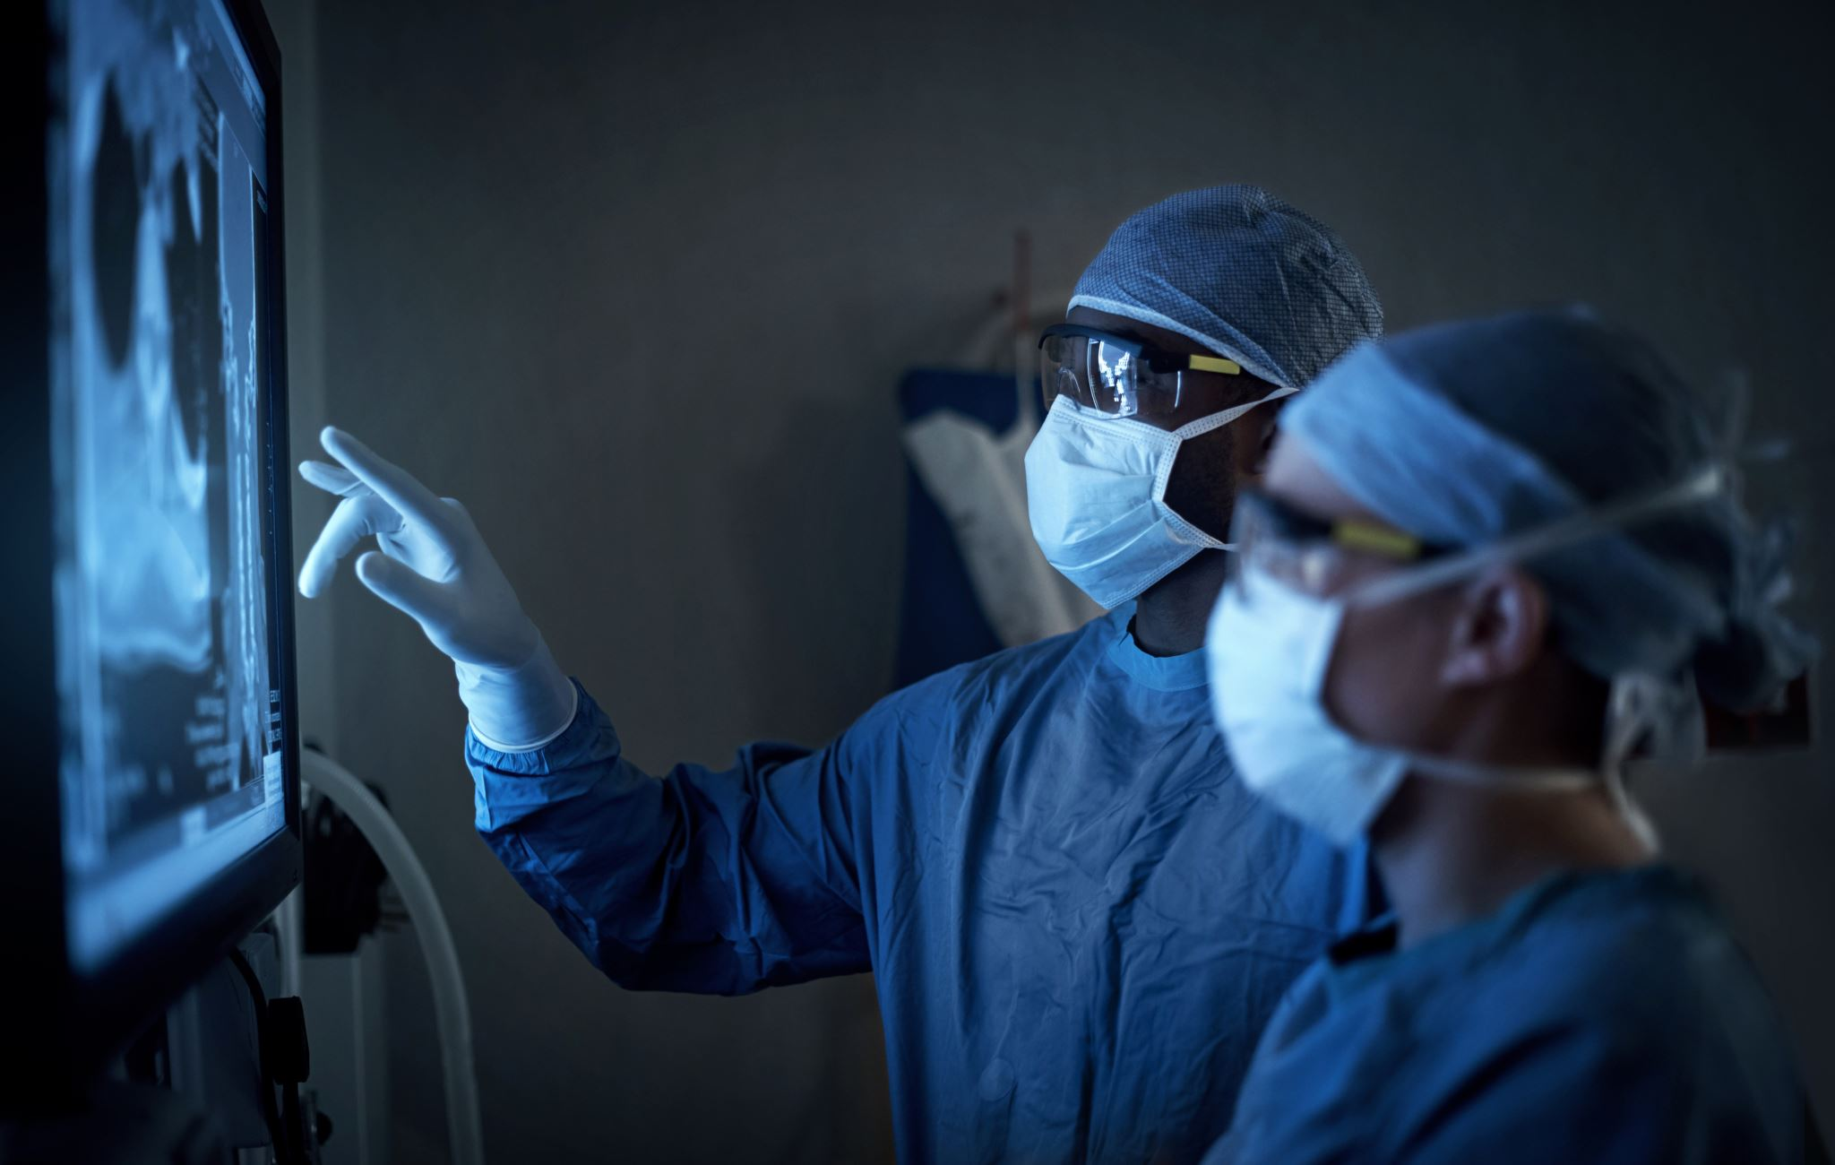
Treatments
Surgery
Chemotherapy
Radiotherapy
Combination

Slide 5
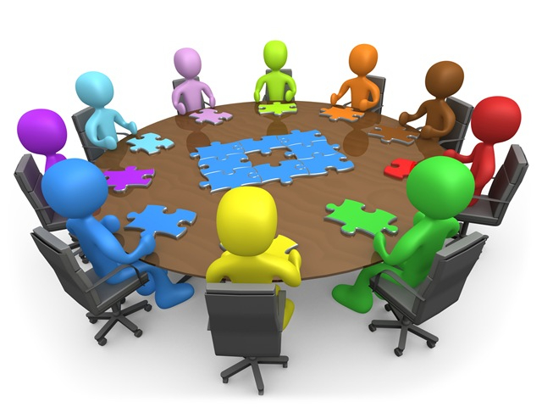
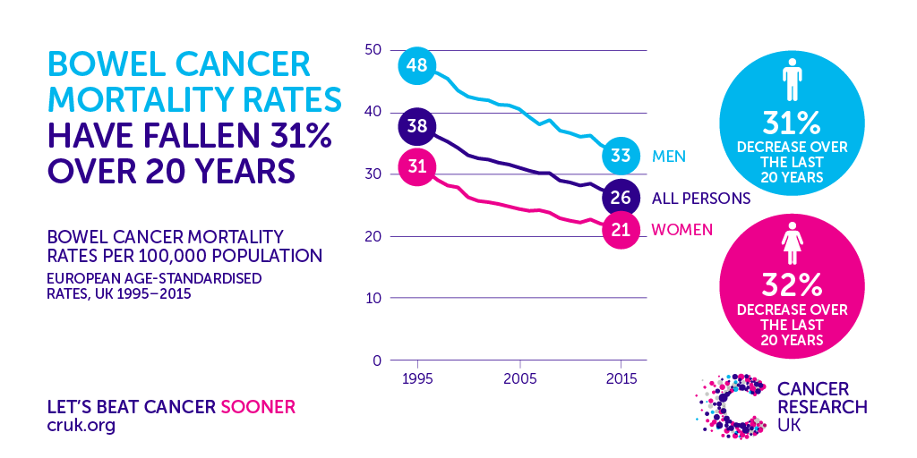
Outcomes
Earlier diagnosis
Better surgery
Better cancer drugs
Better supportive care

Slide 6
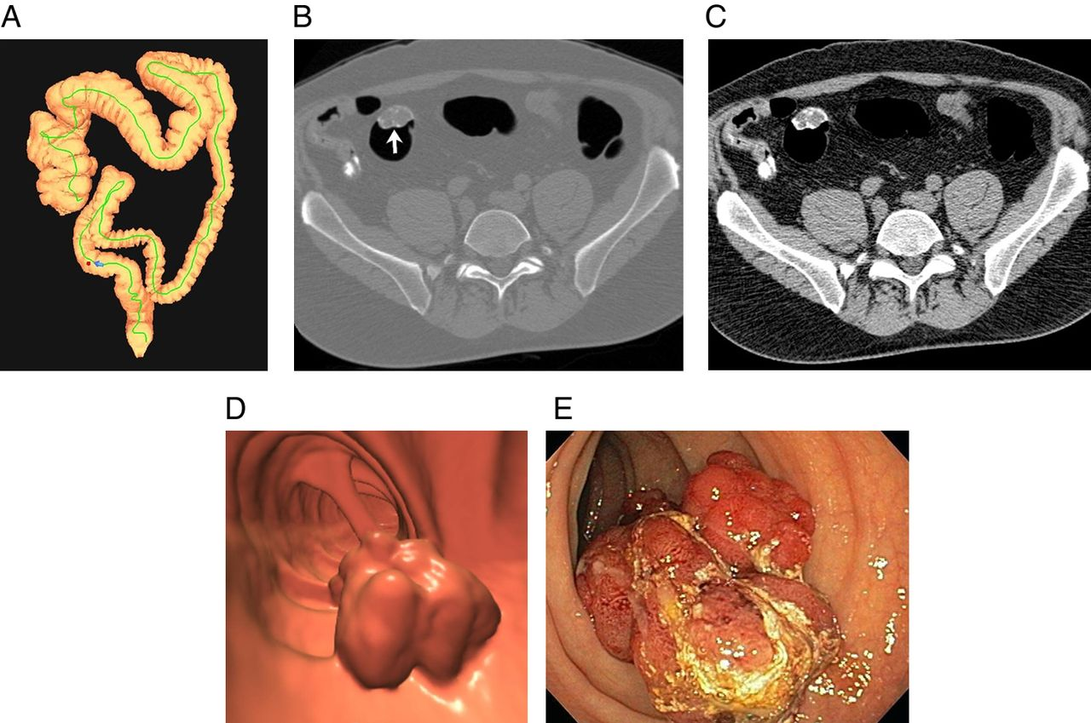
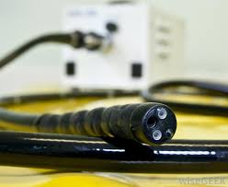
Investigations

Slide 7
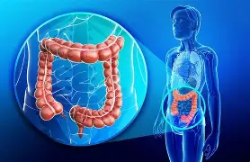
Surgery matters
It is the most effective way to remove bowel cancer
Aim is usually cure – sometimes control or symptom relief
Operations vary depending on:
  Where cancer is
  How advanced it is
  Patient’s overall health

Slide 8
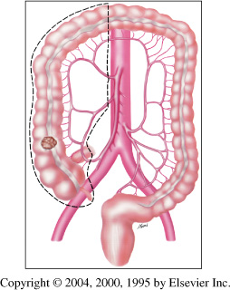
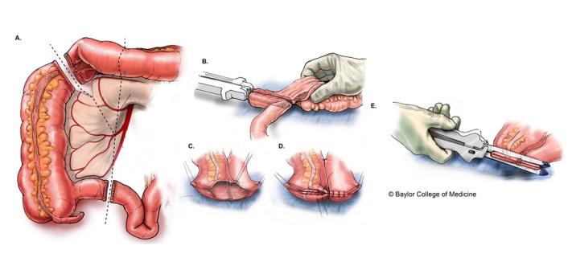
Surgery
Open/Laparoscopic/ Robotic

Slide 9
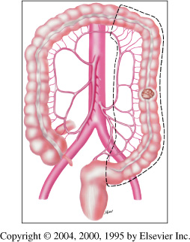
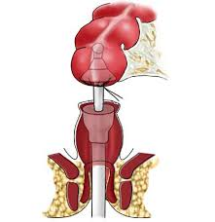
Surgery
Open, Laparoscopic or Robotic

Slide 10
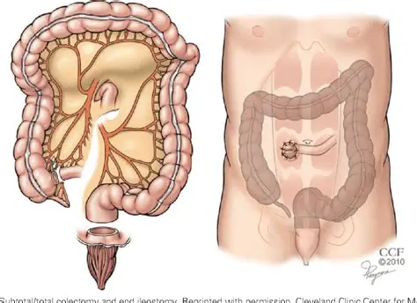
Surgery
Open, Laparoscopic or Robotic

Slide 11
Why might someone need an ileostomy during cancer surgery?
Protection
    Surgery is low in the pelvis
    Radiotherapy has been used
    Healing may be slower or riskier
More than one area of the bowel at the same time
Hereditary (genetics)

Slide 12
Enhanced recovery – After care
Pre-operative
Counselling
Intra-operative
Post-operative
Early diet
Early discharge planning
Reduced fasting duration
Carbohydrate (sugar) loading
No/selective bowel Preparation
Blood clots prevention
Antibiotic prophylaxis
Active warming
Use of multi-modal pain management
Surgical techniques
Avoidance of tubes and drains
Reduce nausea and vomiting
Use of goal directed peri operative fluids
Early mobilization
Early catheter removal
Use of chewing gum
Defined discharge criteria
Use of multi-modal anti-emetics
Use of multimodal pain relief
Use of goal directed fluid therapy

Slide 13
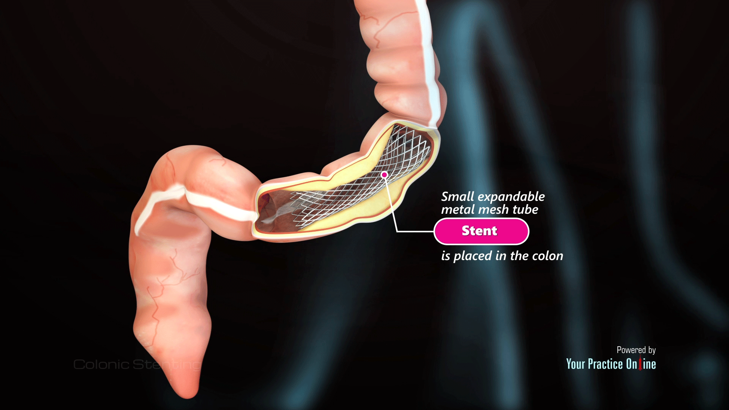
New developments in colon cancer
Bowel cancer screening programme
Stenting of bowel obstruction
Neoadjuvant chemotherapy for high-risk colon cancer patients (FOxTROT)
Immunotherapy
Personalised cancer vaccine

Slide 14
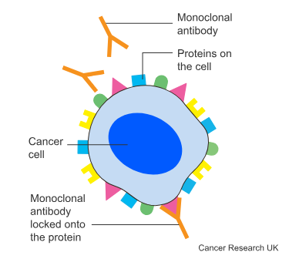
Targeted drugs for advanced bowel cancer
Cetuximab, panitumumab and bevacizumab are type of monoclonal antibodies.
Monocolonal antibodies - recognise and find specific cancer proteins.
They stop proteins from binding to cancer cells or block they protein from triggering the cancer cells to divide and grow.

Slide 15
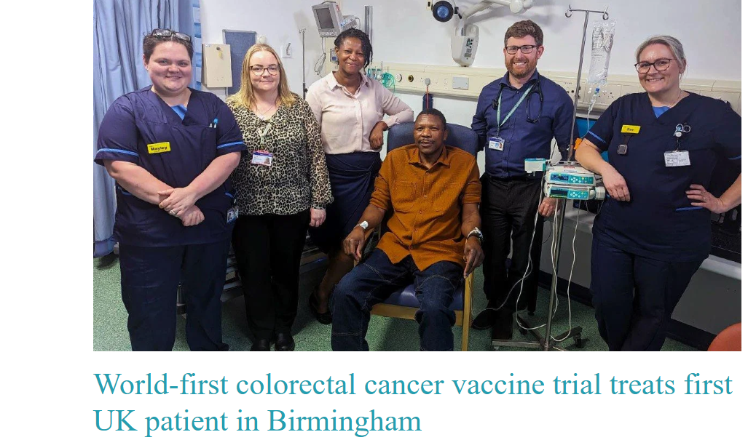
Personalised cancer vaccine trial
Patients provide a sample of their tumour tissue and a blood test
Uses mRNA technology (similar to COVID-19 vaccines)
Each vaccine is individually designed based on genetics.
It is given after surgery
Aims to train the immune system to recognise and attack cancer cells.
Designed to reduce the risk of cancer returning and target any microscopic cancer cells.
Not yet approved for routine use – still in clinical trials.

Slide 16
Complications
After surgery:
Infection or slow wound healing
Leakage from bowel join
Blood clots
Bowel obstruction/adhesions
Stoma-related issues
During chemotherapy or radiotherapy
Fatigue
Nausea or appetite changes
Changes in bowel habit
Dehydration and salt imbalance
Stoma related complications
High output stoma
Skin irritation
Leakages
Hernias
Long term effects
Changes in bowel function
Altered appetite or weight
Tiredness/fatigue
Emotional impact
Complications can happen, but they are part of the treatment, not a failure and most can be managed well with the right support.

Slide 17
Challenges
Late diagnosis
Advanced stage
Pressures on NHS services
Delays in:
Endoscopy services
Scans
Surgery
Oncology appointments
Variations across the country
Advanced surgery
Robotic approaches
Clinical trials
Increasing complexity of patients
Older population
Multiple health issues
Surgery needs tailoring
Recovery may take longer
Effects of radiotherapy and chemotherapy
Living with a stoma
Emotional and psychological impact
Fatigue
Bowel changes
Dehydration
Skin healing
Numbness and tingling
Confidence and body image
High output stomas
Skin problems
Stoma nurses
Specialist dietitians
Peer support
Fear of recurrence
Uncertainty about outcomes
Impact on work, family and intimacy
Emotional fatigue
Complex treatment

Slide 18
Successes
Improved survival and outcomes
Earlier diagnosis through screening and awareness
Better surgical techniques
More effective chemotherapy and radiotherapy
Many patients are cured or live much longer than in the past
Safer and more precise surgery
Improved managing and planning
Minimally invasive and robotic surgery
New technologies
Better surgical education – simulation
Personalised treatment plans
Treatment tailored
MDTs
Patients are increasingly involved in choices
Advances in follow up and support
Better surveillance
Earlier detection of recurrence
Greater recognition of psychological wellbeing
Research and future therapies
Growth of clinical trials
New technologies

Slide 19
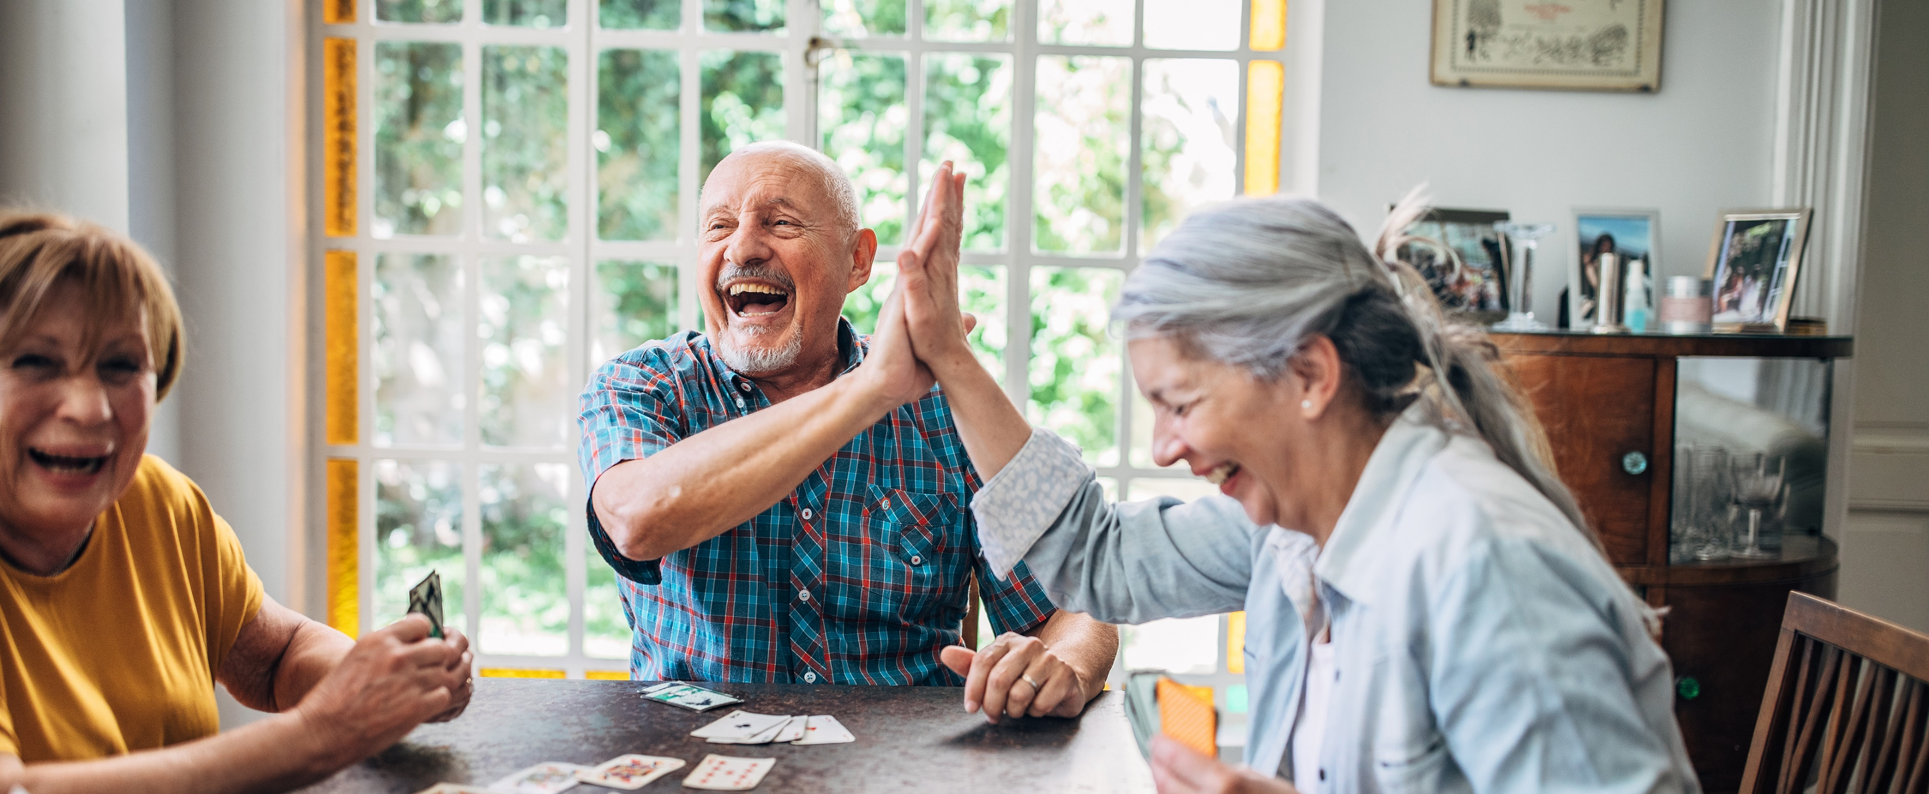
Success in bowel cancer treatment is not just about removing cancer; it is helping people live well afterwards.

Slide 20
Any questions?
Thank you!
Melissa.cunha@uhb.nhs.uk

