Slide 1
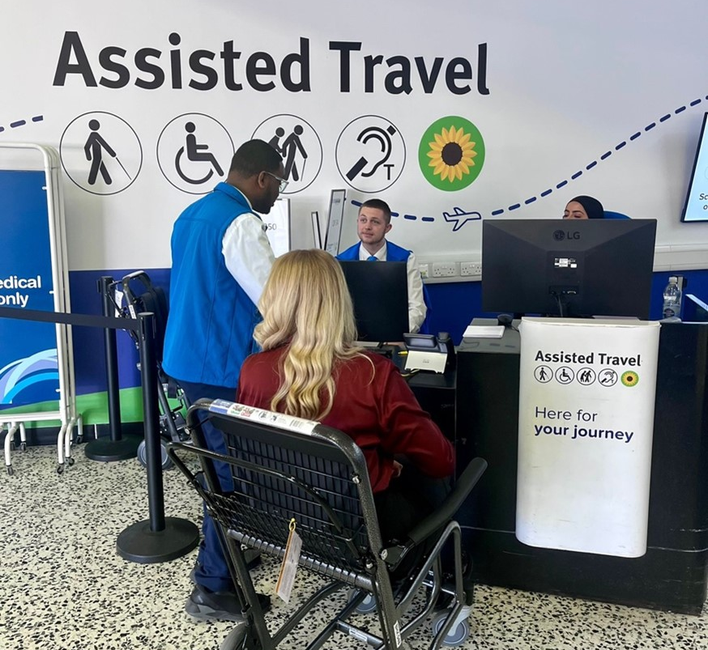
Birmingham Airport Accessibility
May2026

Slide 2
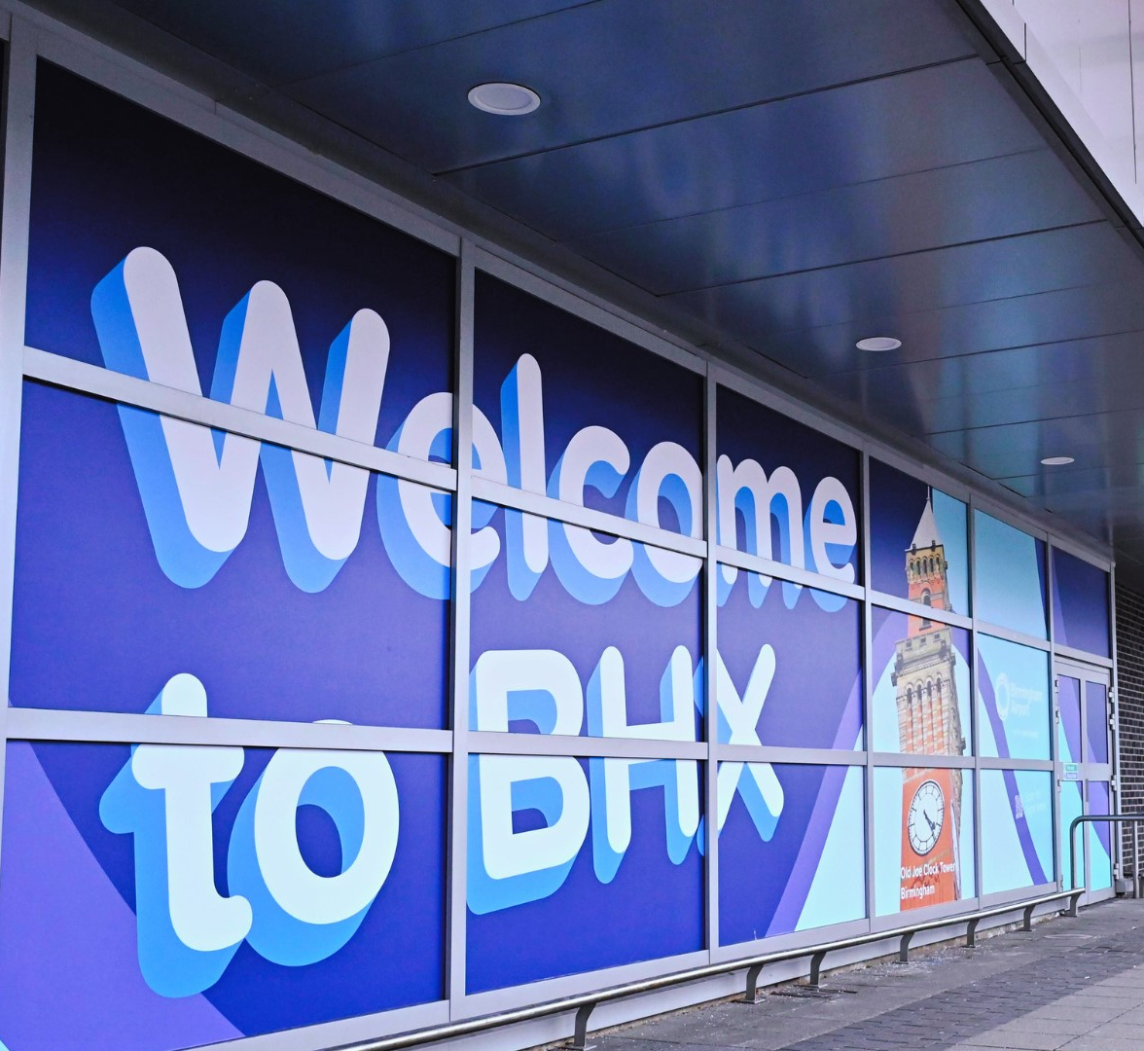
Airport & Assisted Travel
Performance update
May 2026

Slide 3
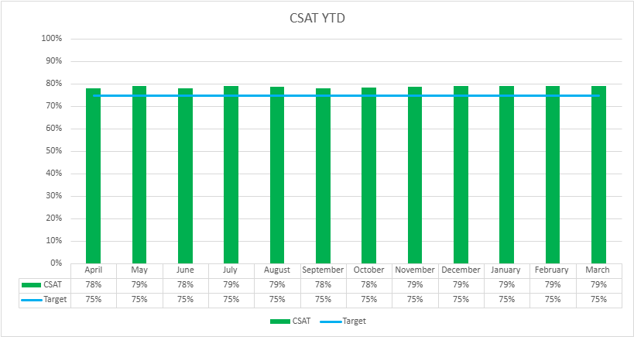
Airport CSAT – YTD
The CSAT Year-to-Date shows consistently strong customer satisfaction performance from April through March. Monthly CSAT scores range between 78% and 79%, remaining above the target of 75% every month. There particularly strong results in Security, Express Lane, and Assisted Travel. Year-to-date performance now averages 78%, showing continued progress following recent investments in service quality and infrastructure.

Slide 4
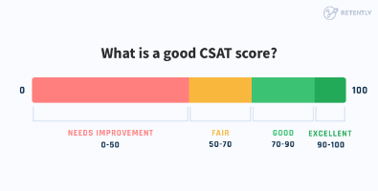
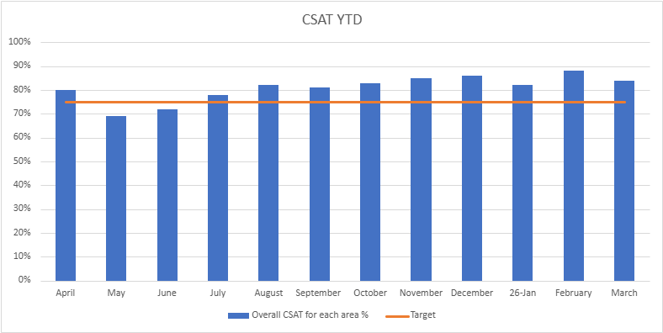
Assisted Travel CSAT scores
Year to date

Slide 6
25/26
Circa £70m capital investment – new aircraft stands, new restaurants, reconfigured operational spaces, additional security capacity, new vehicles, terminal aesthetics
Circa 13.7M passengers travelled through
334,000 of those passengers needed assistance
26/27
Further £80m capital investment planned– new restaurants, departure lounge reconfiguration, baggage capacity upgrades, arrivals journey upgrade, reconfigured operational spaces, new vehicles, new washroom facilities, terminal aesthetics
Circa 14.5M passengers forecast to travel through
395,000 of those passengers expected to need assistance

Slide 7
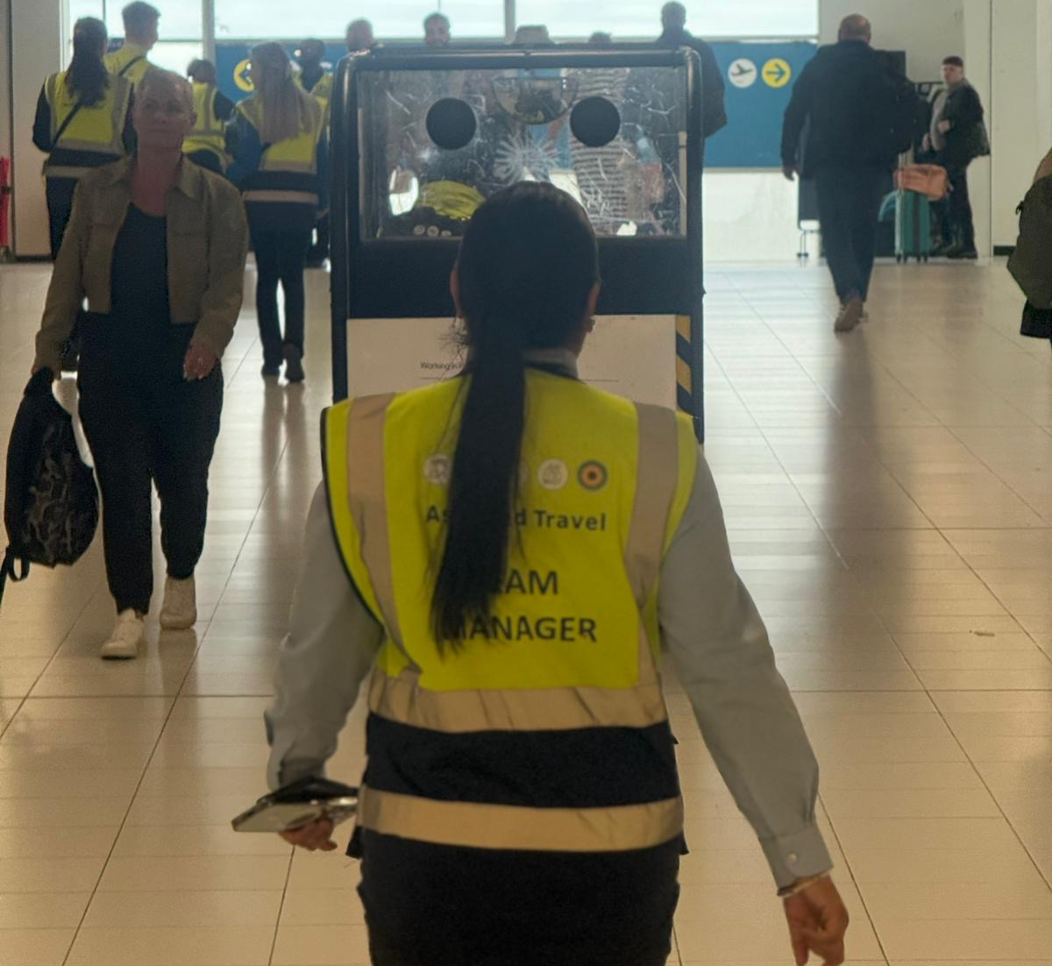
Aviation Security
May 2026

Slide 8
Aviation Security Update
All UK airports were required to install new standard screening equipment by June 2024:
C3 xray technology
Security (Body) Scanner
BHX currently has one area for passenger screening located on the first floor, accessed from Zone B check in area.
From Spring 2026, there are two areas available for passenger screening, Zone A and Zone B.
All passengers seeking to board an aircraft must complete necessary security screening successfully.

Slide 9
The passenger journey through security screening
Passenger Queue Space
  Space allocated on the ground floor, first floor and in front of the lanes for passengers queuing into security.
  Average 15 minutes wait time in peak
  Dedicated queue lane for assisted travel passengers
Access control
  Electronic gates operated by a passenger self scanning boarding passes
  Desks operated by security staff who will scan the boarding passes on behalf of the passenger
Divestment (tray loading).
  There will be a dedicated divestment agent at the tray loading point who will provide instructions about what to load into trays.
  Remove all outer jackets.
  Remove all items from pockets.
  Advise the divestment officer if carrying or wearing a medical device unsuitable for screening by xray or security scanner e.g. those living with stoma bags, continuous glucose monitoring systems, defibrillators, artificial pacemakers….
Removal of Footwear
  There is a regulatory requirement to remove a percentage of footwear for screening via CT (3D) x-ray.
  Security staff at divestment point will randomly select passengers to remove footwear and ask for it to be placed into a tray for screening via CT (3D) x-ray.
  Seating is available for passengers to assist passengers to remove and replace footwear.
  Long handled aids are also available to assist with replacing footwear.

Slide 10
The passenger journey through security screening
Liquids
  Liquids are permitted in containers not exceeding 2 litres.
  These do not need to be removed from bags as the CT (3D) x-rays are equipped with the latest algorithms.
  Liquids in flasks, dual walled containers or take-away cups are not permitted.
  Frozen items are not permitted.
  Should liquids alarm in the x-ray they will require further testing in a dedicated machine. Should security be unable to resolve the alarms, the item/s will not be permitted.
  Ice packs accompanying medication may be permitted on the provision of a doctor’s note and clearing the necessary security screening checks.
Large electrical items
  Items such as laptops, iPads, kindles etc do not need to be removed from bags as the CT (3D) x-rays are equipped with the latest algorithms.
Person screening.
  Birmingham Airport is directed by the DFT to use security scanners to screen departing passengers.
  Passengers who are fitted with external medical devices, internal medical implants and prosthetics are encouraged to make the divestment security officer aware of this prior to stepping into the scanner.
  If the security officer assesses the use of security scanner to be unsuitable then a modified search process will be used.
  This is likely to be carried out in a private area so that a sufficient search can be carried out, whilst protecting the dignity of the passenger.
  A security officer has to reasonably satisfy themselves that no prohibited item is being carried by a passenger.
  This may involve the security officer asking to see worn devices or if medical supports e.g. a knee support, can be removed to check it is not concealing any item.
  Due to security regulations, if a passenger refuses to be searched in accordance with the search regulation, they will not be permitted access to the security restricted part of the airport beyond security and will not be able to board a flight.

Slide 11
Advice for passengers travelling with medical devices or conditions
Don’t forget to bring your medical evidence (e.g. letter from a medical practitioner) to confirm your medical device such as an insulin pump or Continuous Glucose Monitoring system (CGMs). Have this ready to show the Security Officer.
Make the airport Security Officer aware of the device, and exactly what it is and where it is located.
If you are carrying a spare medical device, remove it from your cabin bag before the x-ray and let the Security Officer know.
Do contact the airport if you have any concerns or queries before you travel: note that screening equipment and processes may differ from airport to airport.
Please check with your return airport (if outside the UK) on their arrangements for screening medical devices
Useful information can be found:
Passenger health FAQs: At the airport | UK Civil Aviation Authority
https://www.birminghamairport.co.uk/at-the-airport/security-and-customs/security-scanners/

Slide 12
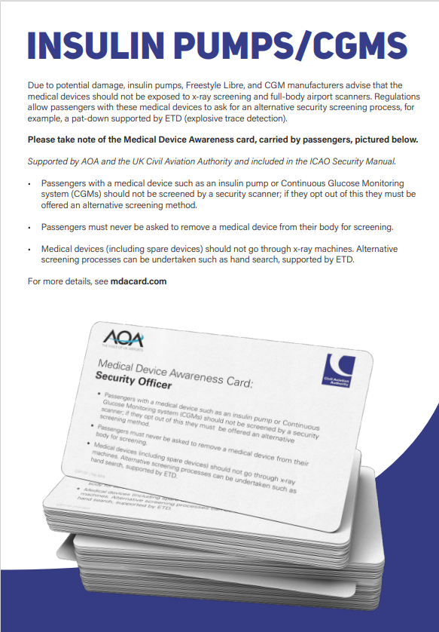
Medical Device Awareness Card
A Medical Device Awareness Card was launched in the UK in 2019, sponsored by the UK Civil Aviation Authority (CAA) and Airport Operators Association (AOA).
The card provides information about insulin pumps and CGMs for airport Security Officers and passengers.

Slide 13
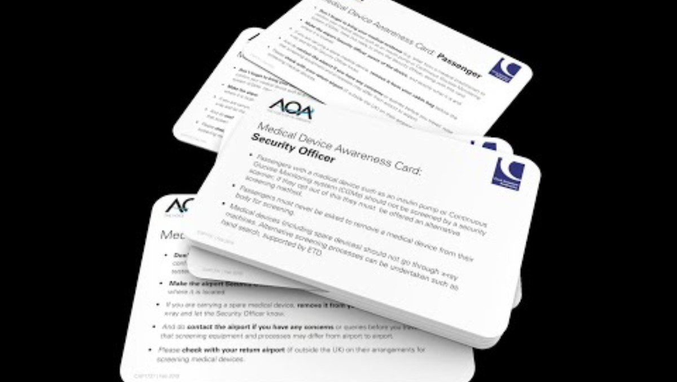
Medical Device Awareness Card
A Medical Device Awareness Card was launched in the UK in 2019, sponsored by the UK Civil Aviation Authority (CAA) and Airport Operators Association (AOA).
The card provides information about insulin pumps and CGMs for airport Security Officers and passengers.

Slide 14


Slide 15
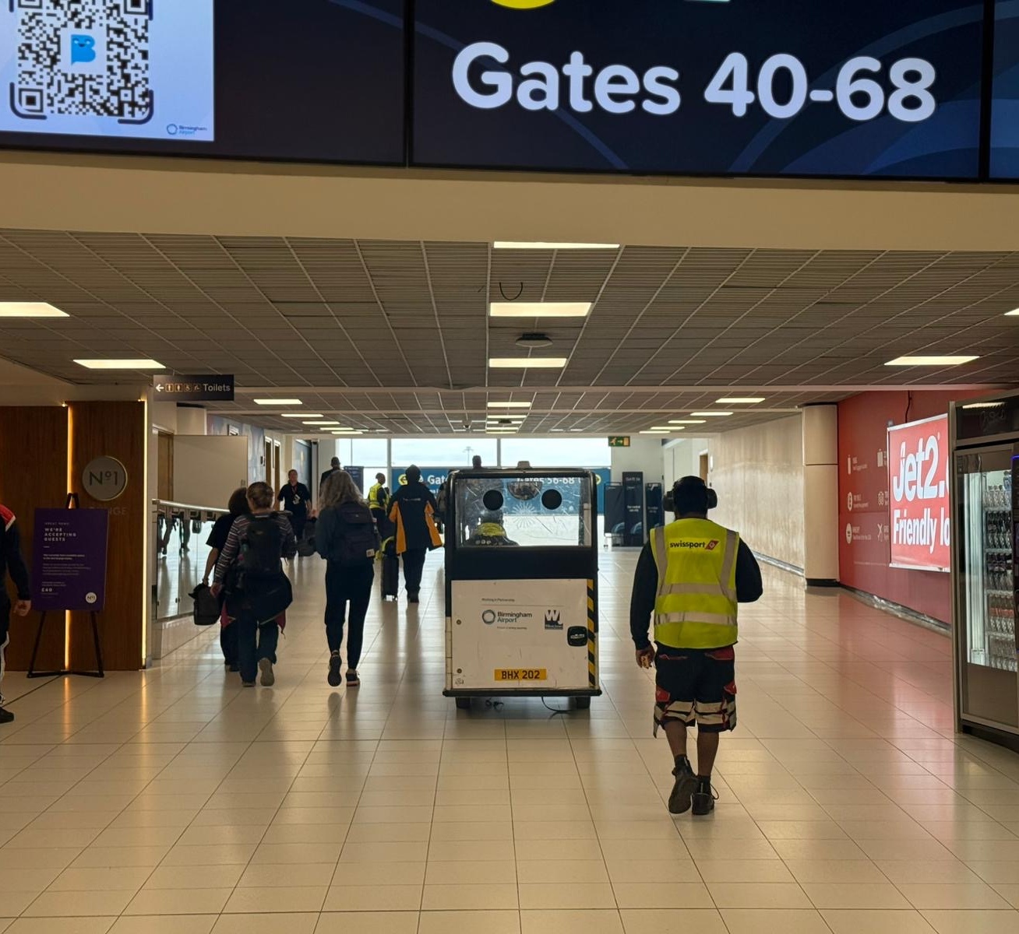
Questions

Slide 16
Thank you.
Arron.Corless@birminghamairport.co.uk – Arron Corless, Accessibility Operations Manager, Birmingham Airport

